Slide 1
Recursion
Notes:
‹#›

Slide 2
Recursion
Recursion is a technique that solves a problem by solving a smaller problem of the same type.
A recursive function is a function invoking itself, either directly or indirectly.
Recursion can be used as an alternative to iteration.
Recursion is an important and powerful tool in problem solving And programming.
Recursion is a programming technique that naturally implements the divide-and-conquer problem solving methodology.

Slide 3
The Nature of Recursion
One or more simple cases of the problem (called the stopping cases or base case) have a simple non-recursive solution.
The other cases of the problem can be reduced (using recursion) to problems that are closer to stopping cases.
Eventually the problem can be reduced to stopping cases only, which are relatively easy to solve.
In general:
if (stopping case)
solve it
else
reduce the problem using recursion
CENG 707
‹#›

Slide 4
Four Questions for Constructing Recursive Solutions
How can you define the problem in terms of a smaller problem of the same type?
How does each recursive call diminish the size of the problem?
What instance of the problem can serve as the base case?
As the problem size diminishes, will you reach this base case?
CENG 707
‹#›

Slide 5
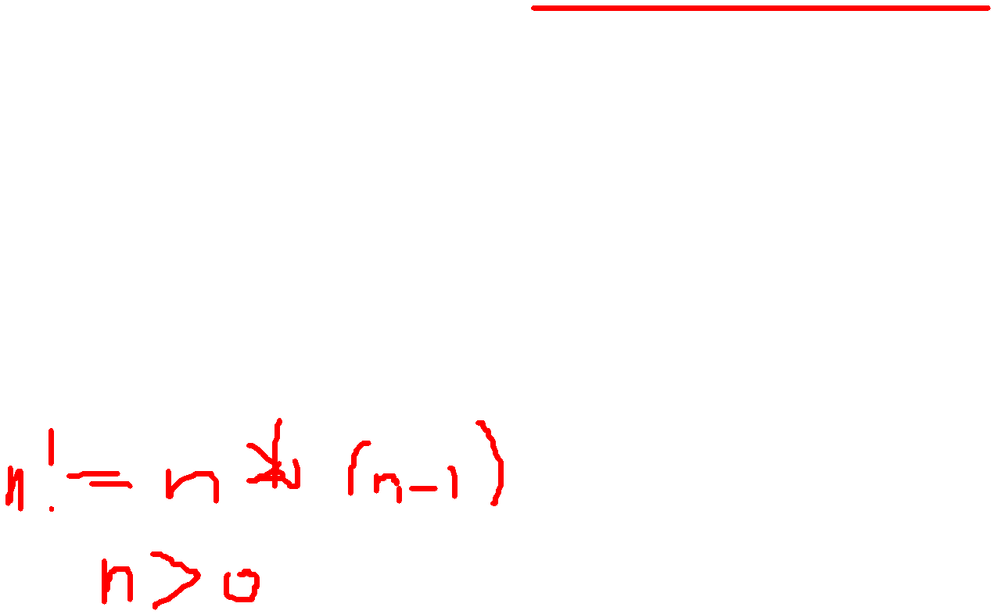
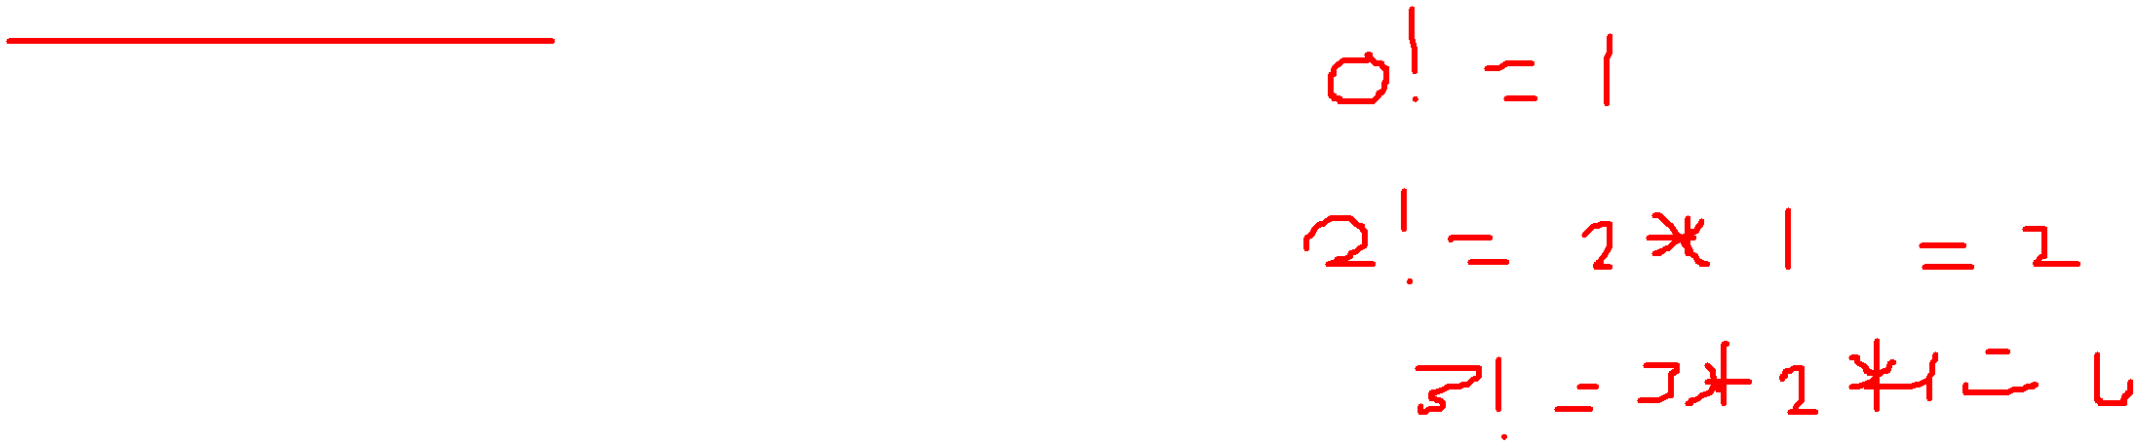
Pseudocode Iterative factorial
n! = n * (n-1) * (n-2) * … * 2 * 1 for any integer n>0
0! = 1
function factorIter(n)
fval = 1;
for (i = n; i >= 1; i--)
fval = fval * i;
return fval;
end function

Slide 6
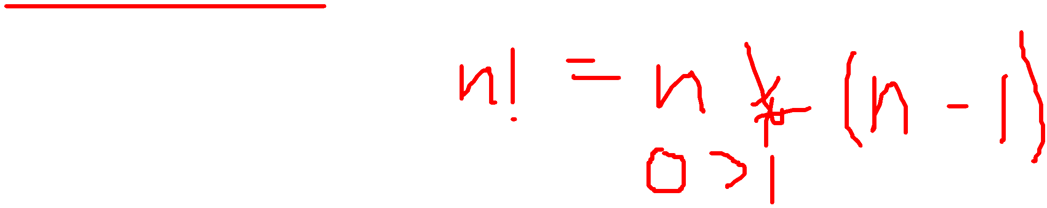
Factorial Function – Iterative Definition
n! = n * (n-1) * (n-2) * … * 2 * 1 for any integer n>0
0! = 1
Iterative Definition in C:
fval = 1;
for (i = n; i >= 1; i--)
fval = fval * i;
return fval;
CENG 707
‹#›

Slide 7
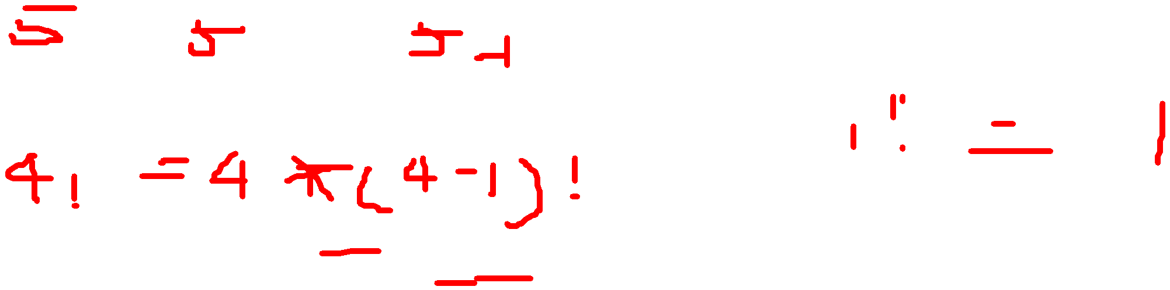
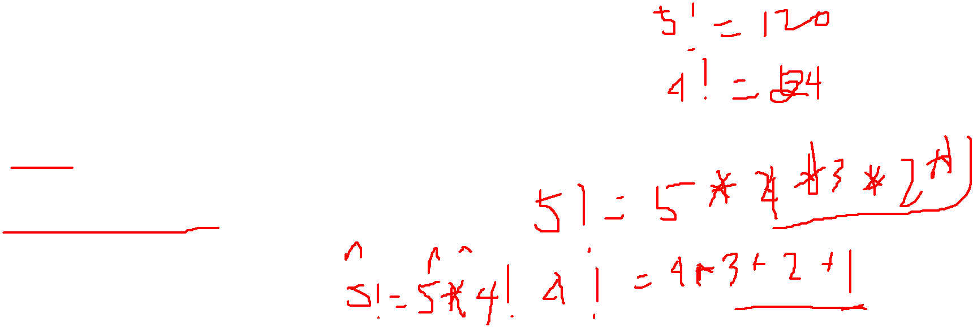
Factorial Function - Recursive Definition
To define n! recursively, n! must be defined in terms of the factorial of a smaller number.
Observation (problem size is reduced):
n! = n * (n-1)!
Base case: 0! = 1
We can reach the base case, by subtracting 1 from n if n is a positive integer.
Recursive Definition:
n! = 1 if n = 0
n! = n*(n-1)! if n > 0
CENG 707
‹#›

Slide 8
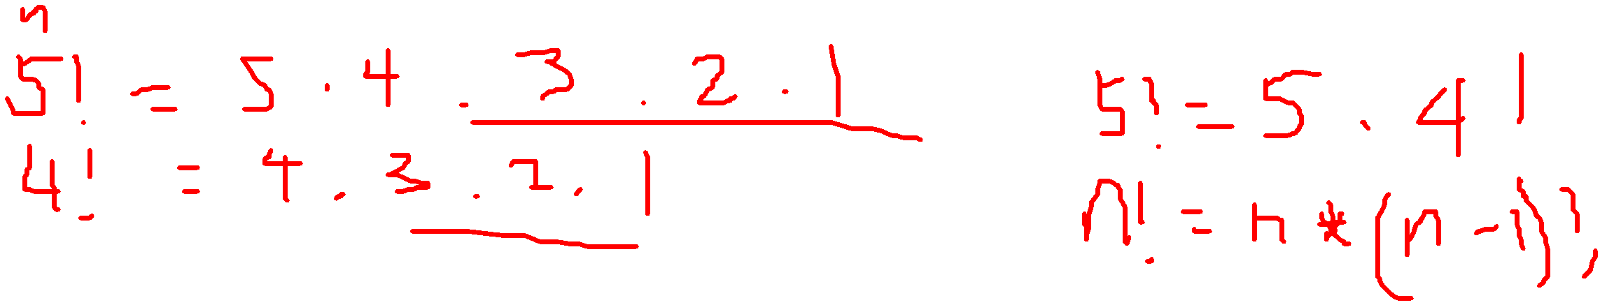
Pseudocode recursive factorial
/* Computes the factorial of a nonnegative integer. Precondition: n must be greater than or equal to 0. Postcondition: Returns the factorial of n; n is unchanged.*/
int fact(int n) {
if (n ==0)
return (1);
else
return (n * fact(n-1));
}
• This fact function satisfies the four criteria of a recursive solution.

Slide 9
Factorial Function - Recursive Definition
/* Computes the factorial of a nonnegative integer. Precondition: n must be greater than or equal to 0. Postcondition: Returns the factorial of n; n is unchanged.*/
int facto(int n) {
if (n ==0)
return (1);
else
return (n * facto(n-1));
}
• This fact function satisfies the four criteria of a recursive solution.

Slide 10
Tracing a Recursive Function
A stack is used to keep track of function calls.
Whenever a new function is called, all its parameters and local variables are pushed onto the stack along with the memory address of the calling statement (this gives the computer the return point after execution of the function)
For each function call, an activation record is created on the stack.
To trace a recursive function, the box method can be used.
The box method is a systematic way to trace the actions of a recursive function.
The box method illustrates how compilers implement recursion.
Each box in the box method roughly corresponds to an activation record.
CENG 707
‹#›

Slide 11
The Box Method (for a valued function)
Label each recursive call in the body of the recursive function.
For each recursive call, we use a different label to distinguish different recursive calls in the body.
These labels help us to keep track of the correct place to which we must return after a function call completes.
After each recursive call, we return to the labeled location, and substitute that recursive call with returned valued.
if (n ==0)
return (1);
else
return (n * fact(n-1) )
A
CENG 707
‹#›

Slide 12
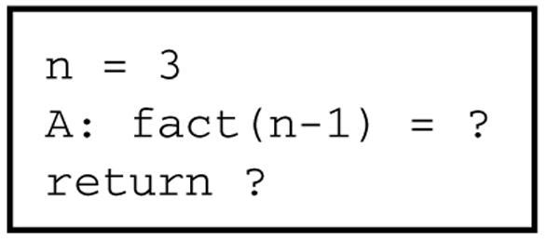
The Box Method (continued)
Each time a function is called, a new box represents its local environment. Each box contains:
the values of the arguments,
the function local variables
A placeholder for the value returned from each recursive call from the current box. (label in step 1)
The value of the function itself.
CENG 707
‹#›

Slide 13
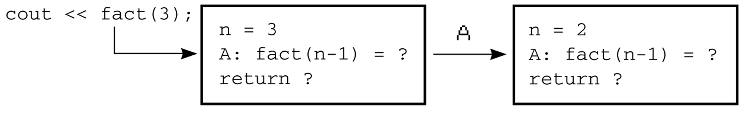
The Box Method (continued)
Draw an arrow from the statement that initiates the recursive process to the first box.
Then draw an arrow to a new box created after a recursive call, put a label on that arrow.
printf(“%d”, fact (3));
CENG 707
‹#›

Slide 14
The Box Method (continued)
After a new box is created, we start to execute the body of the function.
On exiting a function, cross off the current box and follow its arrow back to the box that called the function.
This box becomes the current box.
Substitute the value returned by the just-terminated function call into the appropriate item in the current box.
Continue the execution from the returned point.
CENG 707
‹#›

Slide 15
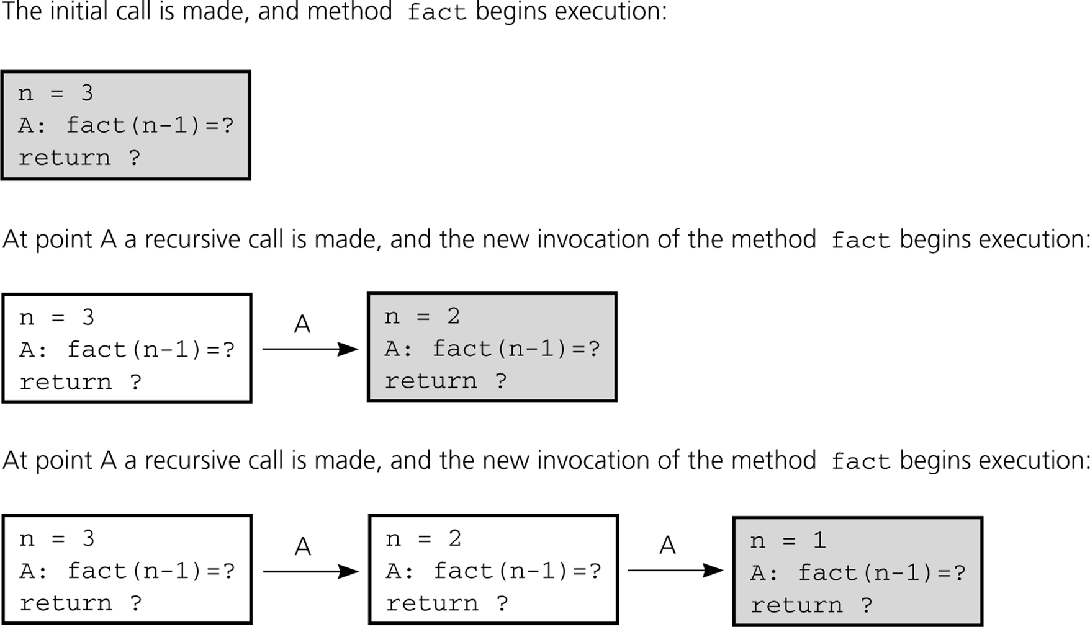
Box Trace of fact(3)
CENG 707
‹#›

Slide 16
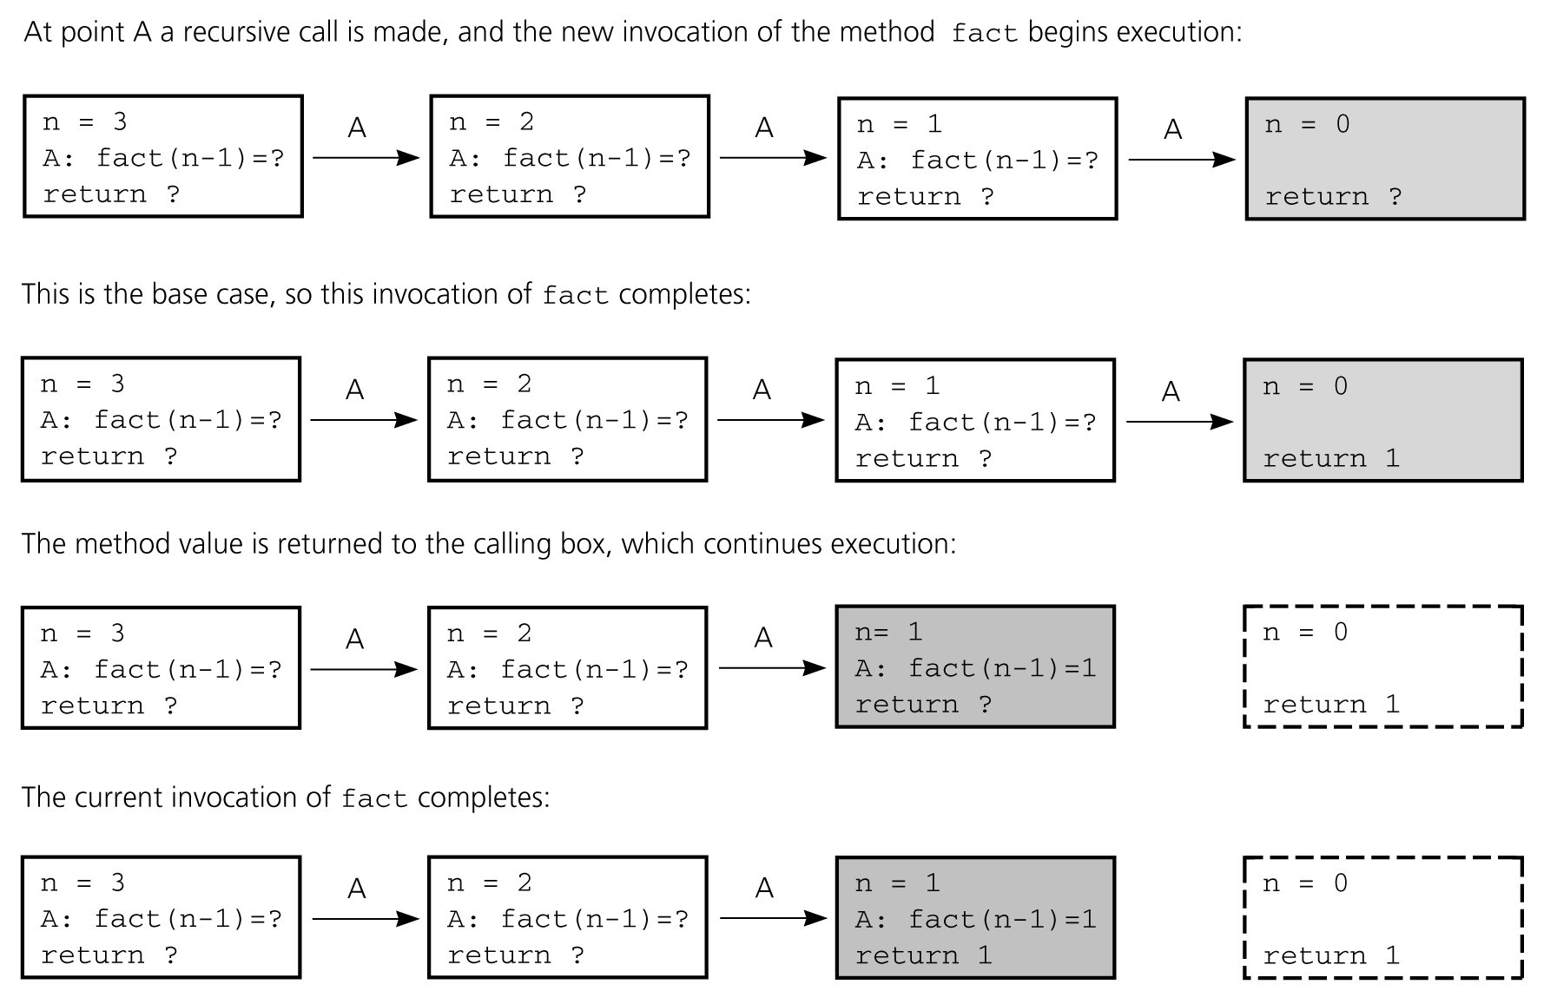
Box Trace of fact(3) (continued)
CENG 707
‹#›

Slide 17
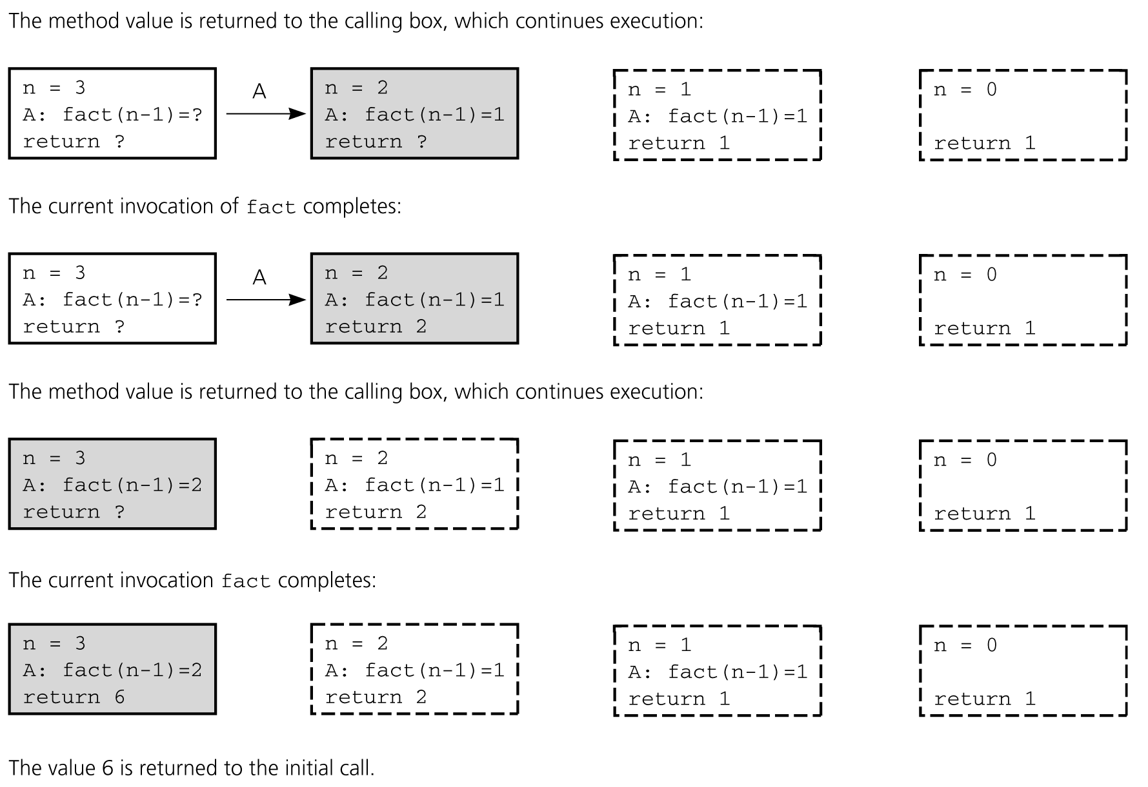
Box Trace of fact(3) (continued)

Slide 18
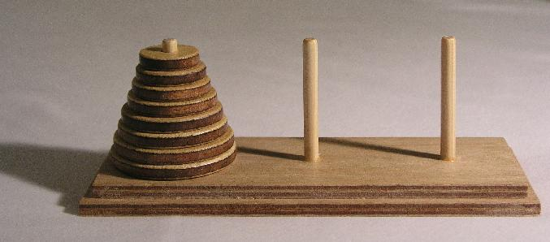
More Interesting Example Towers of Hanoi
Move stack of disks from one peg to another
Move one disk at a time
Larger disk may never be on top of smaller disk
Notes:
‹#›

Slide 19
A Legend
Legend has it that there were three diamond needles set into the floor of the temple of Brahma in Hanoi.
Stacked upon the leftmost needle were 64 golden disks, each a different size, stacked in concentric order:

Slide 20
A Legend (Ct’d)
The priests were to transfer the disks from the first needle to the second needle, using the third as necessary.
But they could only move one disk at a time, and could never put a larger disk on top of a smaller one.
When they completed this task, the world would end!

Slide 21
To Illustrate
For simplicity, suppose there were just 3 disks, and we’ll refer to the three needles as A, B, and C...
Since we can only move one disk at a time, we move the top disk from A to B.

Slide 22
Example
For simplicity, suppose there were just 3 disks, and we’ll refer to the three needles as A, B, and C...
We then move the top disk from A to C.

Slide 23
Example (Ct’d)
For simplicity, suppose there were just 3 disks, and we’ll refer to the three needles as A, B, and C...
We then move the top disk from B to C.

Slide 24
Example (Ct’d)
For simplicity, suppose there were just 3 disks, and we’ll refer to the three needles as A, B, and C...
We then move the top disk from A to B.

Slide 25
Example (Ct’d)
For simplicity, suppose there were just 3 disks, and we’ll refer to the three needles as A, B, and C...
We then move the top disk from C to A.

Slide 26
Example (Ct’d)
For simplicity, suppose there were just 3 disks, and we’ll refer to the three needles as A, B, and C...
We then move the top disk from C to B.

Slide 27
Example (Ct’d)
For simplicity, suppose there were just 3 disks, and we’ll refer to the three needles as A, B, and C...
We then move the top disk from A to B.

Slide 28
Example (Ct’d)
For simplicity, suppose there were just 3 disks, and we’ll refer to the three needles as A, B, and C...
and we’re done!
The problem gets more difficult as the number of disks increases...

Slide 29
Our Problem
Today’s problem is to write a program that generates the instructions for the priests to follow in moving the disks.
While quite difficult to solve iteratively, this problem has a simple and elegant recursive solution.

Slide 30
Design
Basis: What is an instance of the problem that is trivial?
→ n == 1
Since this base case could occur when the disk is on any needle, we simply output the instruction to move the top disk from src to dest.

Slide 31
Design
Basis: What is an instance of the problem that is trivial?
→ n == 1
Since this base case could occur when the disk is on any needle, we simply output the instruction to move the top disk from src to dest.

Slide 32
Design (Ct’d)
Induction Step: n > 1
→ How can recursion help us out?
a. Recursively move n-1 disks from src to aux.

Slide 33
Design (Ct’d)
Induction Step: n > 1
→ How can recursion help us out?
b. Move the one remaining disk from src to dest.

Slide 34
Design (Ct’d)
Induction Step: n > 1
→ How can recursion help us out?
c. Recursively move n-1 disks from aux to dest...

Slide 35
Design (Ct’d)
Induction Step: n > 1
→ How can recursion help us out?
d. We’re done!

Slide 36
Algorithm
We can combine these steps into the following algorithm:
0. Receive n, src, dest, aux.
1. If n > 1:
a. Move(n-1, src, aux, dest);
b. Move(1, src, dest, aux);
c. Move(n-1, aux, dest, src);
Else
Display “Move the top disk from “, src, “ to “, dest.
End if.

Slide 37
Tower of Hanoi Program
/* PRE: n >= 0. Disks are arranged small to large on the pegs a, b, and c. At least n disks on peg a. No disk on b or c is smaller than the top n disks of a.
POST: The n disks have been moved from a to c. Small to large order is preserved. Other disks on a, b, c are undisturbed. */
void move (int n, int a, int c, int b) {
if (n > 0)
{
move (n-1, a, b, c);
printf ("Move one disk from %d to %d\n", a, c);
move (n-1, b, c, a);
} // if (n > 0)
return;
} // move
#include <stdio.h>
void move (int n, int a, int c, int b);
int main() {
int disks;
printf ("How many disks?");
scanf ("%d", &disks);
move (disks, 1, 3, 2);
return 0;
} // main
Notes:
‹#›

Slide 38
Tower of Hanoi Program
/* PRE: n >= 0. Disks are arranged small to large on the pegs a, b, and c. At least n disks on peg a. No disk on b or c is smaller than the top n disks of a.
POST: The n disks have been moved from a to c. Small to large order is preserved. Other disks on a, b, c are undisturbed. */
void move (int n, int a, int c, int b) {
if (n > 0)
{
move (n-1, a, b, c);
printf ("Move one disk from %d to %d\n", a, c);
move (n-1, b, c, a);
} // if (n > 0)
return;
} // move
#include <stdio.h>
void move (int n, int a, int c, int b);
int main() {
int disks;
printf ("How many disks?");
scanf ("%d", &disks);
move (disks, 1, 3, 2);
return 0;
} // main
If pre-condition is satisfied here, is it still satisfied here?
And here?
Notes:
‹#›

Slide 39
Tower of Hanoi Program
/* PRE: n >= 0. Disks are arranged small to large on the pegs a, b, and c. At least n disks on peg a. No disk on b or c is smaller than the top n disks of a.
POST: The n disks have been moved from a to c. Small to large order is preserved. Other disks on a, b, c are undisturbed. */
void move (int n, int a, int c, int b) {
if (n > 0)
{
move (n-1, a, b, c);
printf ("Move one disk from %d to %d\n", a, c);
move (n-1, b, c, a);
} // if (n > 0)
return;
} // move
#include <stdio.h>
void move (int n, int a, int c, int b);
int main() {
int disks;
printf ("How many disks?");
scanf ("%d", &disks);
move (disks, 1, 3, 2);
return 0;
} // main
If pre-condition is true and if n = 1, does move satisfy the post-condition?
Can we reason that this program correctly plays Tower of Hanoi?
Notes:
‹#›

Slide 40
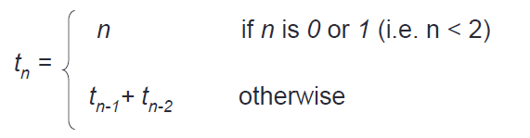
Assignment
Write a recursive function to obtain fibonacci series up to the integer entered by the user with the following fibonacci definition:
Sample output:
Enter the number of series: 7
The fibonacci series are:
0
1
1
2
3
5
8

